Slide 1
Module 5 ..part1..IRS indexing & searching
1)Searching….offline….preprocessing the text document…then forming index terms of document..query..keywords identified….comparison…searching
2)Search..online….documents cannot be preprocessed….searching of patterns…as there are chances that the document will change…can be used when number and document size is small
3)Suppose document numbers and size is large…a data structure can be built on the documents….clustering….relevant and irrelevant document sets

Slide 2
Module 5 ..part1..IRS indexing & searching
2)Inverted files…….
a)It is a process to find the orientation of the words in the documents
b)The inverted file structure has.. occurrence and vocabulary
c)Vocabulary…what are the words comming in the document
d)Occurrence…for each word present a list is made as what is the position in which the word occurs
e)This inverted file or inverted index helps to find…..
f)Which word occur the most, what is their distance from each other
g)This inverted file takes more space as ,this is done for characters like……. hypen, comas

Slide 3
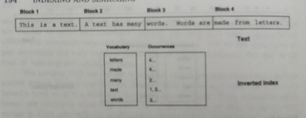
Module 5 ..part1..IRS indexing & searching
2)Inverted files….
a)Solution is block addressing
b)Now the text is divided into number of blocks
c)Now each individual word, character or symbol is not pointed but only the block is pointed
d)now vocabulary is the words, symbols , characters
e) occurrence is only the block number

Slide 4
Module 5 ..part1..IRS indexing & searching
2)Inverted files…. What operations can be done on the inverted file
2.1) Vocabulary search… for a query the words ,symbols, characters are seperated and search in the inverted list for their presence in the document.
2.2)Where their is a match that document is selected for further checking
2.3) Retrievel of occurrence…now suppose inverted file has 20 entires were
The…10,20 30….
Was…22,33,44…
proper noun..45 67
Then only proper now terms are selected and THE or WAS which is the most …

Slide 5
Module 5 ..part1..IRS indexing & searching
2)Inverted files…. What operations can be done on the inverted file
2.4)Retrievel of occurrences……nearest to it is selected as adjective to get its meaning more clear
2.5)Manipulation of occurrence… occurrences are processed for..solving boolean expression, forming phases, evaluating proximity, eliminating unwanted word sets
2.6)Other indices for text….
2,6,1)Suffix tree and suffix array
a)Select the text, within the text select the sentences, now select the index points (may be proper noun in sentences)

Slide 6
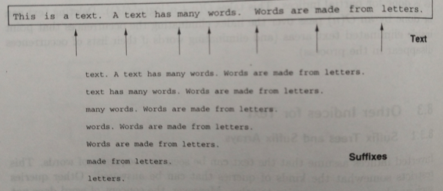
Module 5 ..part1..IRS indexing & searching
2)Inverted files….
2.6) Other indices for text….
2.6.1) Suffix tree and suffix array
Eg index word is considered to be
the suffix and remaining word séquence is évaluated

Slide 7
Module 5 ..part1..IRS indexing & searching
2)Inverted files…. 2.6) Other indices for text….
2.6.2)Structure……
a)Now tree is created of the sufffixes taped
b)All those branches which have single leaf as w.r.t the root node are removed
c)That branch which had maxinum number of nodes is selected as it has more meaning
2.6.3) Signature files…..
a)This works on hash function which is a unique binary combination for a text block in the sequence.

Slide 8
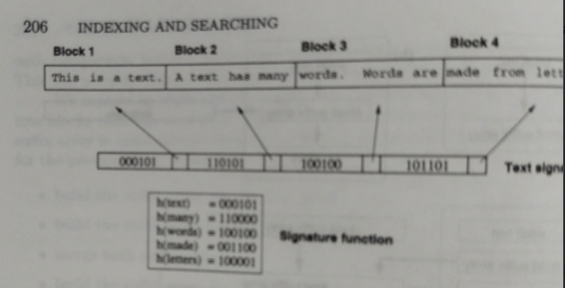
Module 5 ..part1..IRS indexing & searching
2.6.3)Signature files…..
This works on hash function which is a unique binary combination for a text block in the séquence.

Slide 9
Module 5 ..part1..IRS indexing & searching
2.6.3)Signature files…..
This works on hash function which is a unique binary combination for a text block in the séquence.
2.6.4)Boolean queries…
a)Set manipulation algorithms are used
b) Now we have set of results, were 11 means exact matching, 01 and 10 means partial relevance and 00 means no matching
c) So for exalt matching AND operation is performed. For any of the one OR operation is performed and for filtering ,NOT operation is performed

Slide 10
Module 5 ..part1..IRS indexing & searching
3)Séquentiel searching….
This is used when their is no stucture of documents avalable for comparison
In this case selection of document only depends on keyword and index mapping
3.1)Types of algorthm…
a)Brute force
a.1) select the document..it will have O(n) diffèrent word position combination . Each word combination is examined with time period O(m).
a.2) so the wost can time for scanning all combinations will be O(mn)

Slide 11
Module 5 ..part1..IRS indexing & searching
3)Séquentiel searching….
3.1)Types of algorthm…a)Brute force
a.1) select the document..it will have O(n) diffèrent word position combination . Each word combination is examine with time period O(m).
a.2) so the wost can time for scanning all combinations will be O(mn)
a.3) now the accuarcy of index formation will be more for a lesser value of Acc (m1) Acc(m2)……
b) knuth-morris-pratt..
Intsead of checking the entire document a part of it is selected and checked

Slide 12
Module 5 ..part1..IRS indexing & searching
3)Séquentiel searching….
3.1)Types of algorthm…
b) knuth-morris-pratt..
Instead of checking the entire document a part of it is selected and checked
If matched next part selected with reference to first
This method is called as window moving

Slide 13
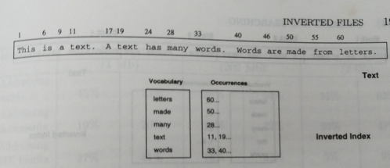
Module 5 ..part1..IRS indexing & searching
2) Inverted files….
a)This inverted file takes more space as ,this is done for characters like…… capital letters ,small letters
b)Similarly for symbols like…hypen, fullstop, comas etc
all this occupies lot of space

Slide 14
Module 5 ..part1..IRS indexing & searching
4)Multimedia IR….
a) mutimedia has various mutimedia on objects like videio, text . Image ect
b) All this is avaliable in one place in multimédia document
c) Query is called as multimédia query
5) Automatic feature extraction.
a)Automated feature extraction uses specialized algorithms or deep networks to extract features automatically from signals or images without the need for human intervention. This technique can be very useful when you want to move quickly from raw data to developing machine learning algorithms.

Slide 15
Module 5 ..part1..IRS indexing & searching
5) Automatic feature extraction.
Givening unique words 1 or 0 and selection only those labelled as 1
Keeping count of occurrence of words…mostly repeated words….their nearness of context
6) Searching web…web crawler, web engine

Slide 16
Module1 ..part3..IRS
Thank You

